Slide 1
How feedback influences galaxy redshift-space distortions
Jim van Veenhuyzen, 11-6-2024
Project Supervisor: Dr. Marcel van Daalen

Slide 2
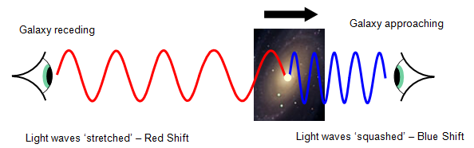
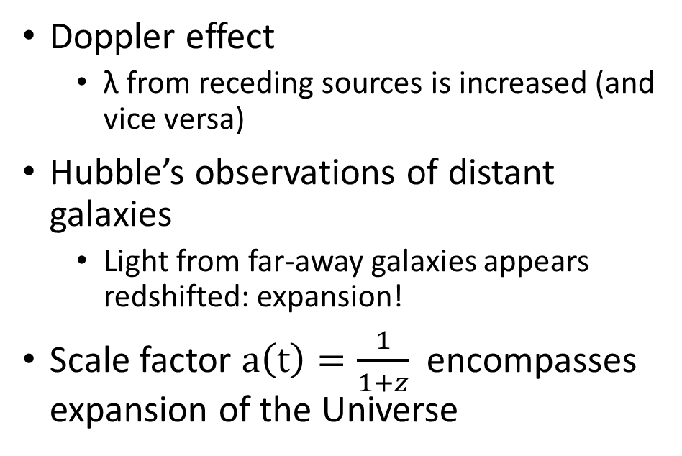
Introduction: Galaxies and expansion
Doppler effect
λ from receding sources is increased (and vice versa)
Hubble’s observations of distant galaxies
Light from far-away galaxies appears redshifted: expansion!
Scale factor $a\left(t\right)=\frac{1}{1+z}$ encompasses expansion of the Universe

Slide 3
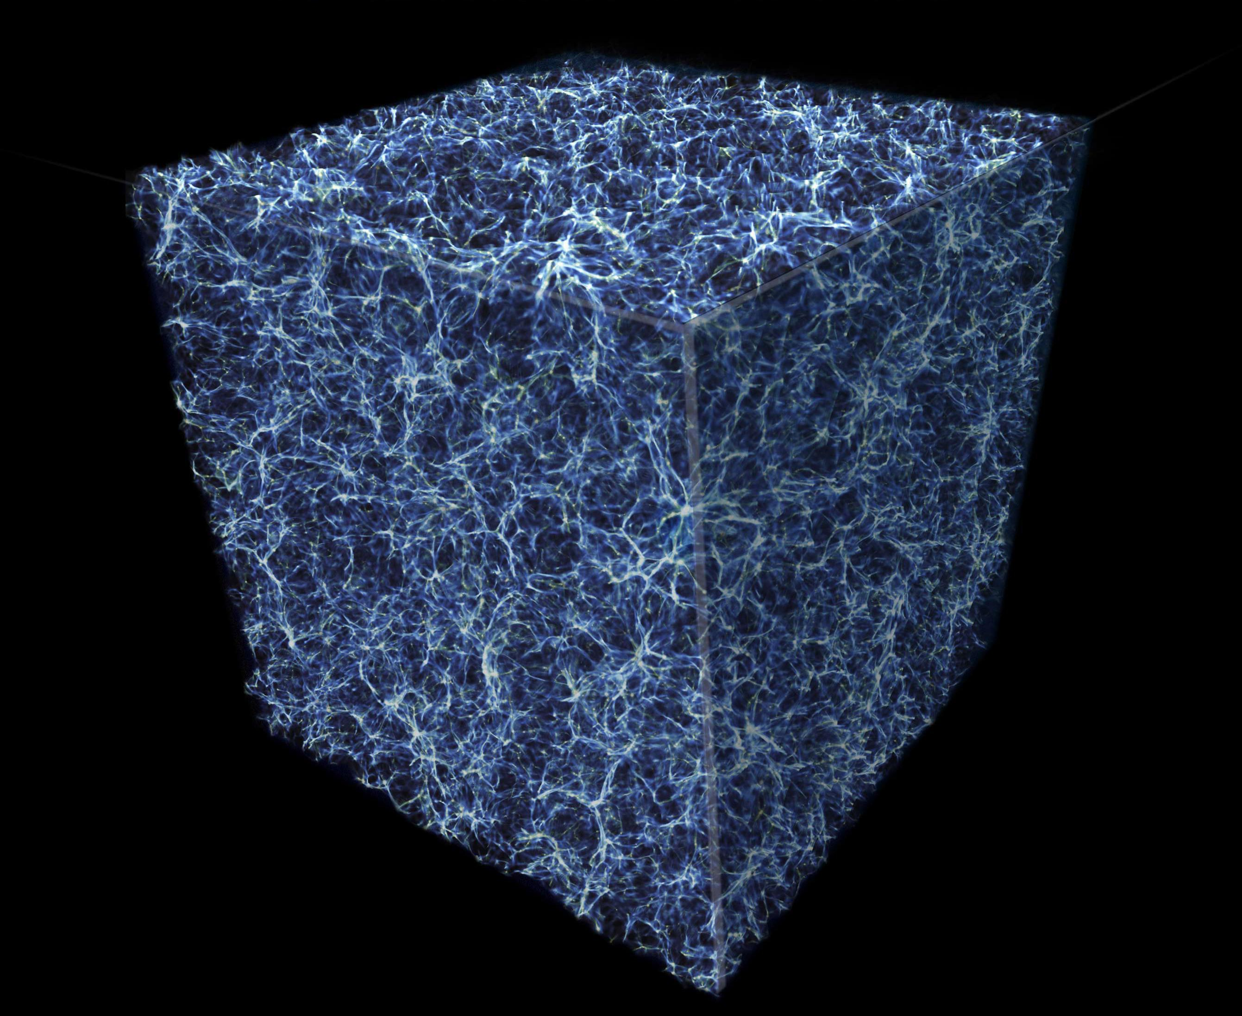
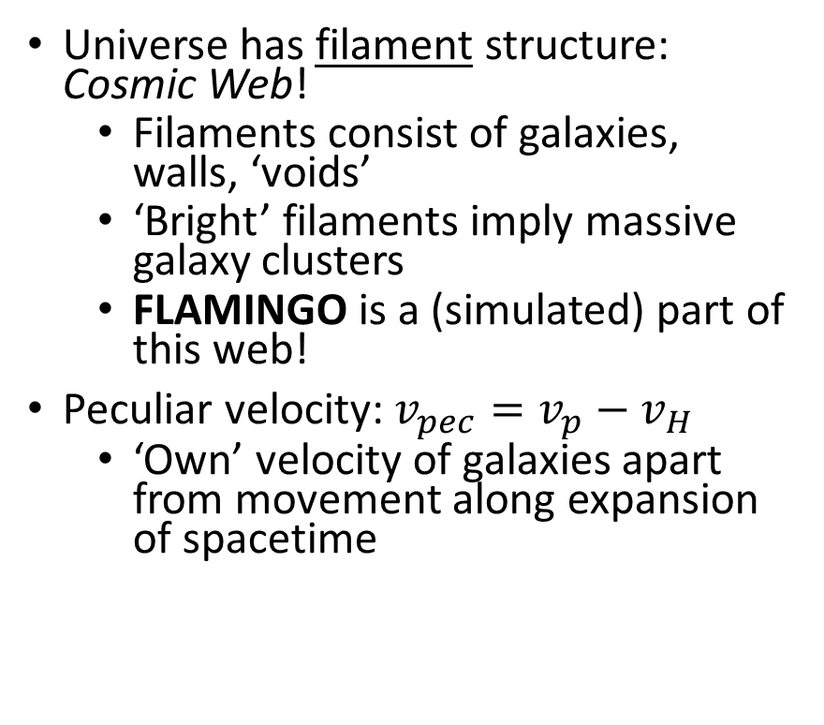
Introduction: The universe at the largest scale
Universe has filament structure: Cosmic Web!
Filaments consist of galaxies, walls, ‘voids’
‘Bright’ filaments imply massive galaxy clusters
FLAMINGO is a (simulated) part of this web!
Peculiar velocity: $v_{pec}=v_{p}−v_{H}$
‘Own’ velocity of galaxies apart from movement along expansion of spacetime
Notes:
We recover the metric tensor if we take a(t)=1 (steady state cosmology)

Slide 4
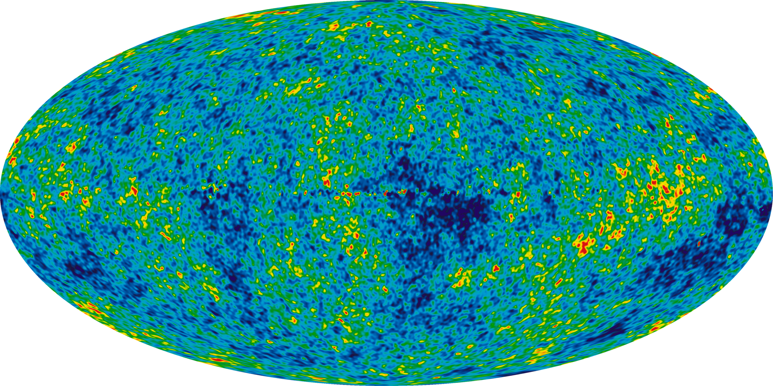
Introduction: Power spectrum
Density fluctuation strength P(k) as a function of scale k [h/Mpc]
Fourier Transform of density contrast δ(x)
Allows us to quantify the anisotropy of galaxies inside FLAMINGO!
Now that we have the background covered…

Slide 5
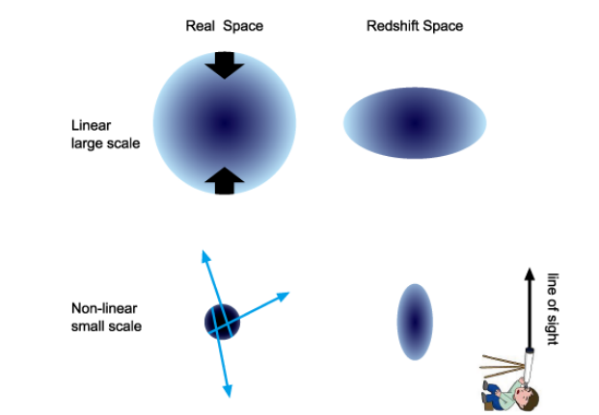
Introduction: Redshift-Space Distortions
Two ‘distortion’ effects occur on both small and large scales
Both of these ‘RSD’ effects perturb Hubble’s law
Infalling motion of galaxies toward cluster center on large scales: Kaiser effect
Virialized velocity dispersions of galaxies inside clusters on small scales: Fingers-of-God

Slide 6
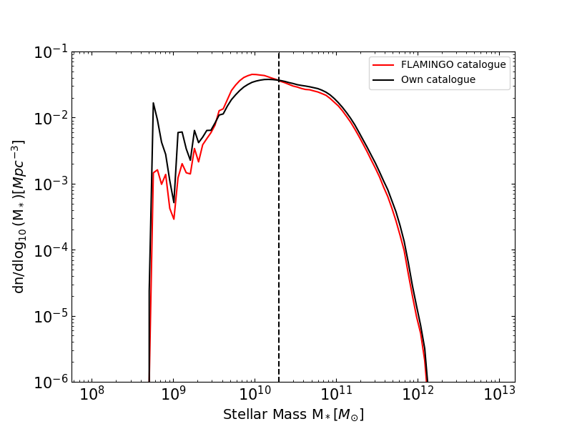
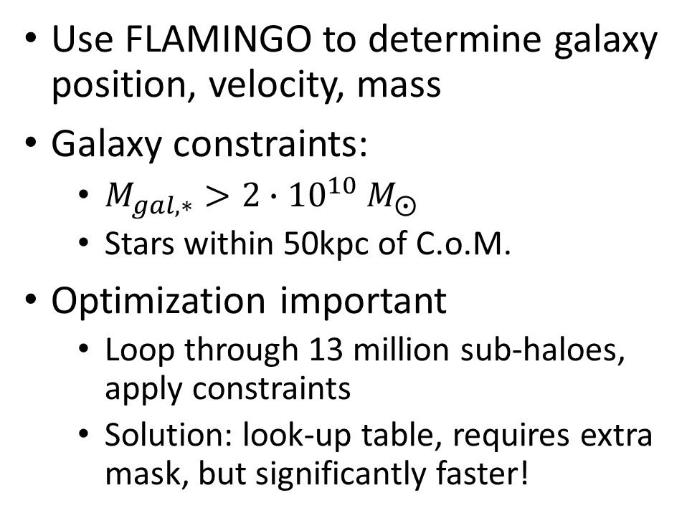
Methods: Creating a galaxy catalogue
Use FLAMINGO to determine galaxy position, velocity, mass
Galaxy constraints:
$M_{gal,∗}>{2∙10}^{10} M_{⨀}$
Stars within 50kpc of C.o.M.
Optimization important
Loop through 13 million sub-haloes, apply constraints
Solution: look-up table, requires extra mask, but significantly faster!

Slide 7
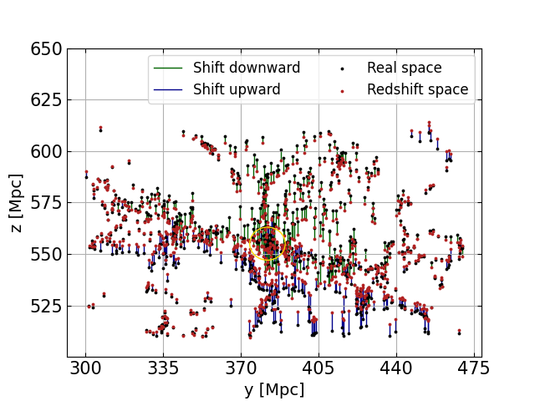
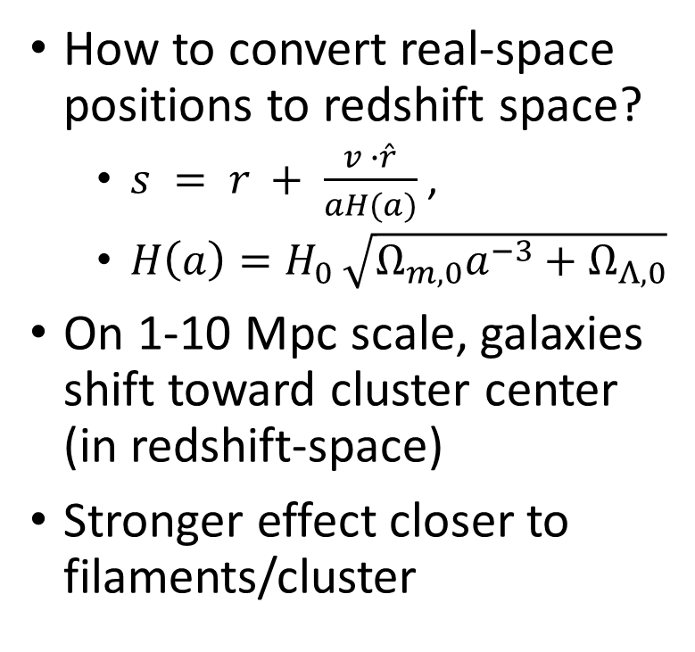
Methods: Redshift-space positions
How to convert real-space positions to redshift space?
$s = r + \frac{v ∙\hat{r}}{aH(a)}$,
$H\left(a\right)=H_{0 }\sqrt{Ω_{m,0}a^{−3}+Ω_{Λ,0}}$
On 1-10 Mpc scale, galaxies shift toward cluster center (in redshift-space)
Stronger effect closer to filaments/cluster

Slide 8
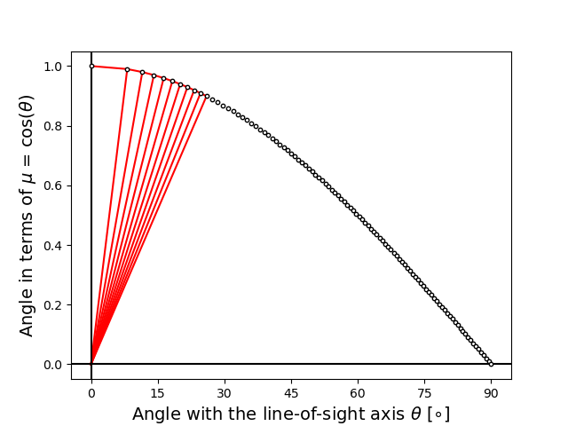
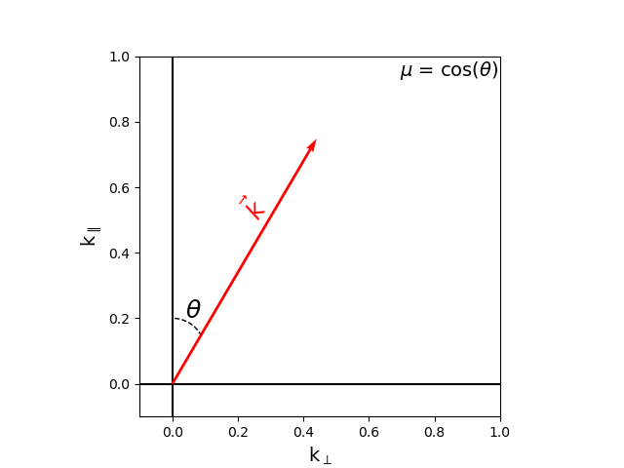
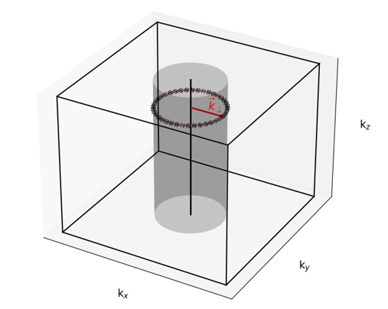
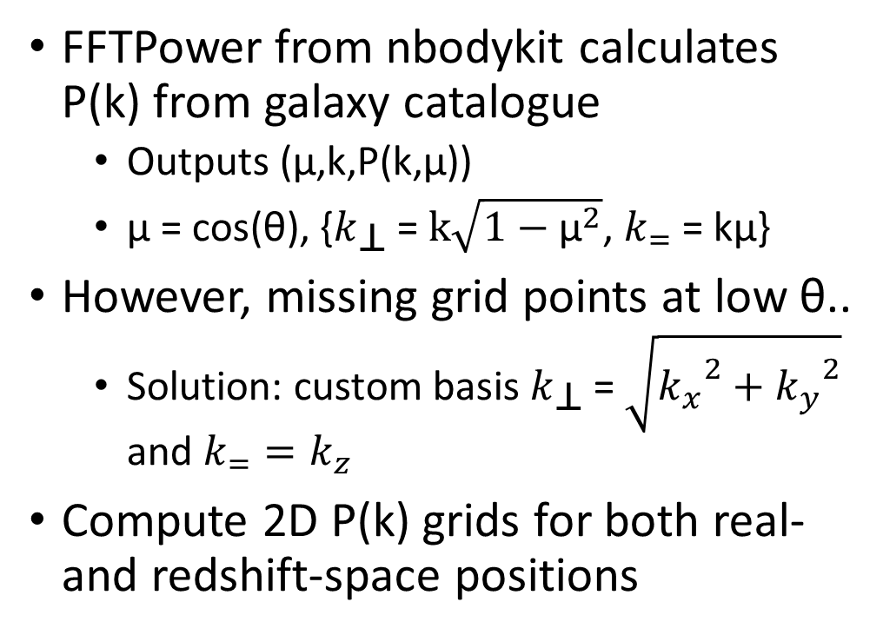
Methods: 2D power-spectrum grid
FFTPower from nbodykit calculates P(k) from galaxy catalogue
Outputs (μ,k,P(k,μ))
μ = cos(θ), {$k_{\text{⊥}}$ = $k\sqrt{1−{\text{μ}}^{2}}$, $k_{=}$ = kμ}
However, missing grid points at low θ..
Solution: custom basis $k_{\text{⊥}}$ = $\sqrt{{k_{x}}^{2}+{k_{y}}^{2}}$ and $k_{=}=k_{z}$
Compute 2D P(k) grids for both real- and redshift-space positions

Slide 9
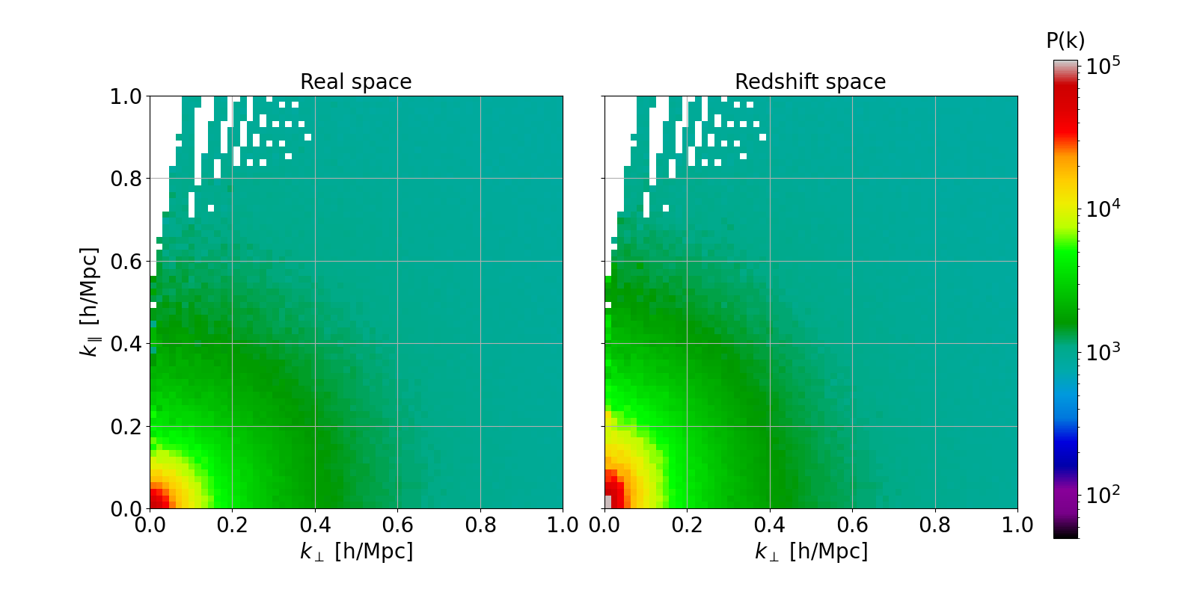
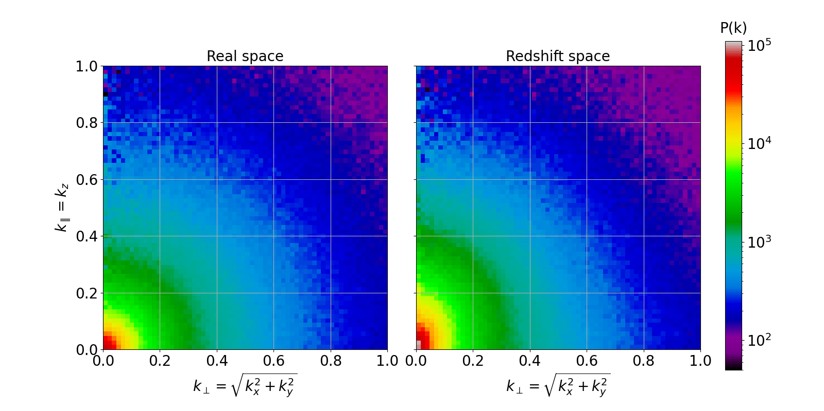

The real- and redshift position grids before (left) and after (right) re-binning
Next step: modelling the $\frac{P_{RSD}}{P_{Real}}$ grid! But first…

Slide 10
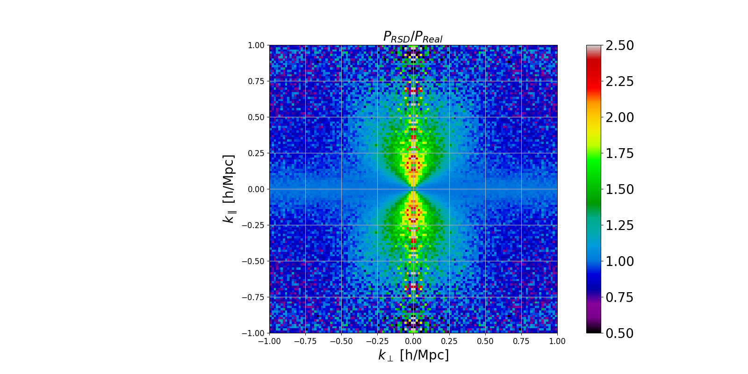
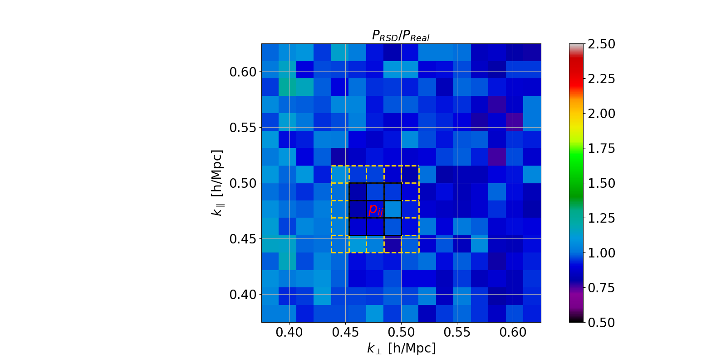
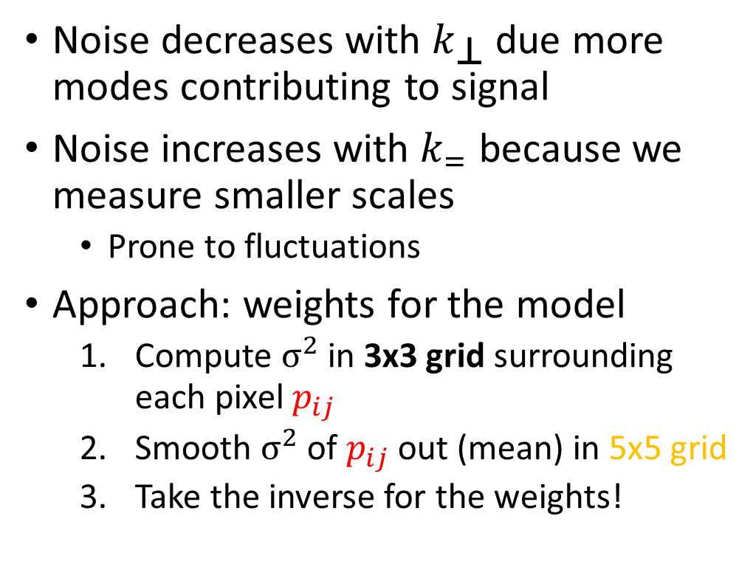
Methods: Weights
Noise decreases with $k_{\text{⊥}}$ due more modes contributing to signal
Noise increases with $k_{=}$ because we measure smaller scales
Prone to fluctuations
Approach: weights for the model
Compute $σ^{2}$ in 3x3 grid surrounding each pixel $p_{ij}$
Smooth $σ^{2}$ of $p_{ij}$out (mean) in 5x5 grid
Take the inverse for the weights!

Slide 11
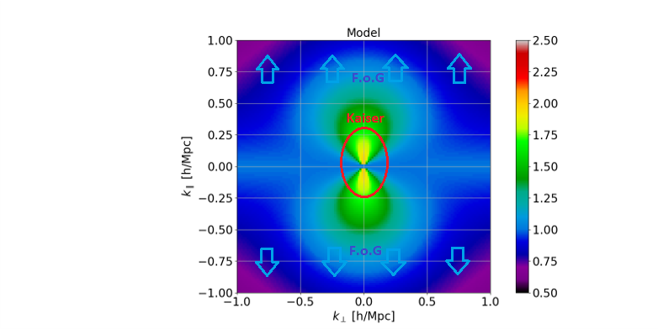
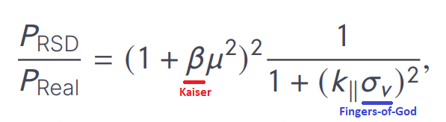
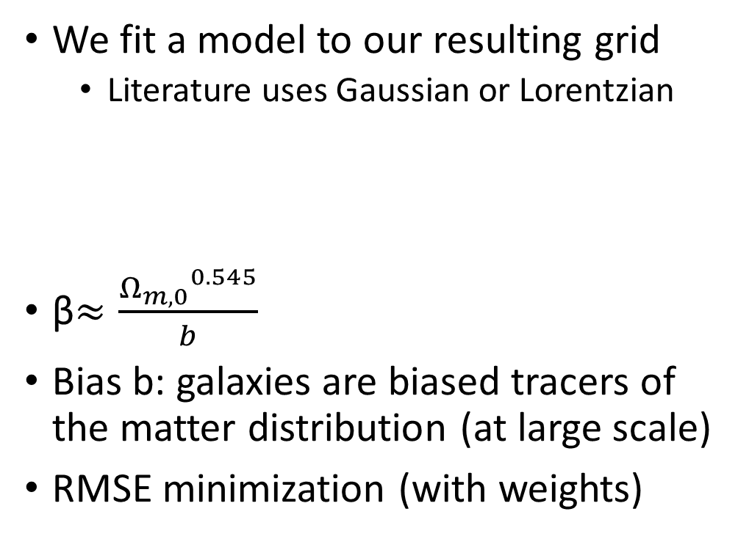
Methods: Redshift-Space Distortion model
We fit a model to our resulting grid
Literature uses Gaussian or Lorentzian
β$≈\frac{{Ω_{m,0}}^{0.545}}{b}$
Bias b: galaxies are biased tracers of the matter distribution (at large scale)
RMSE minimization (with weights)

Slide 12
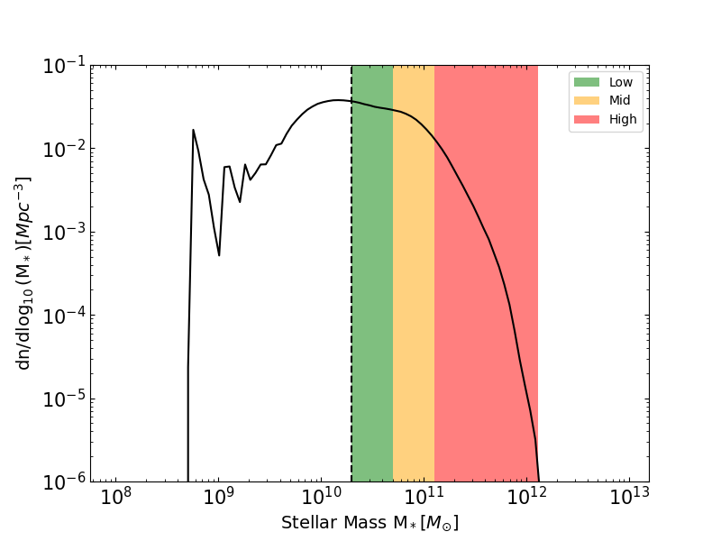
Methods: different simulations
Mass bins
Low
Mid
High
Higher redshifts
z=0.5,1.0,2.0 (,0.8,1.5)
Vary AGN feedback strength in combination with mass

Slide 13
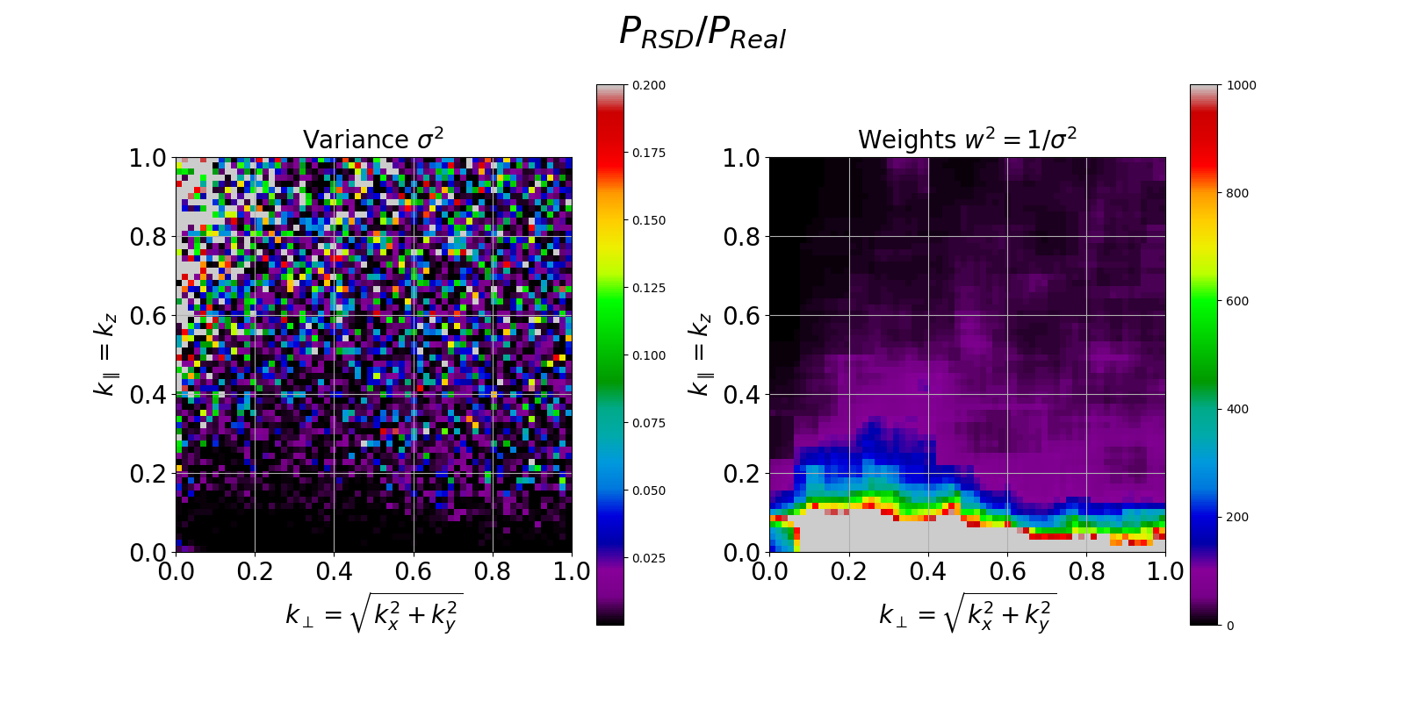
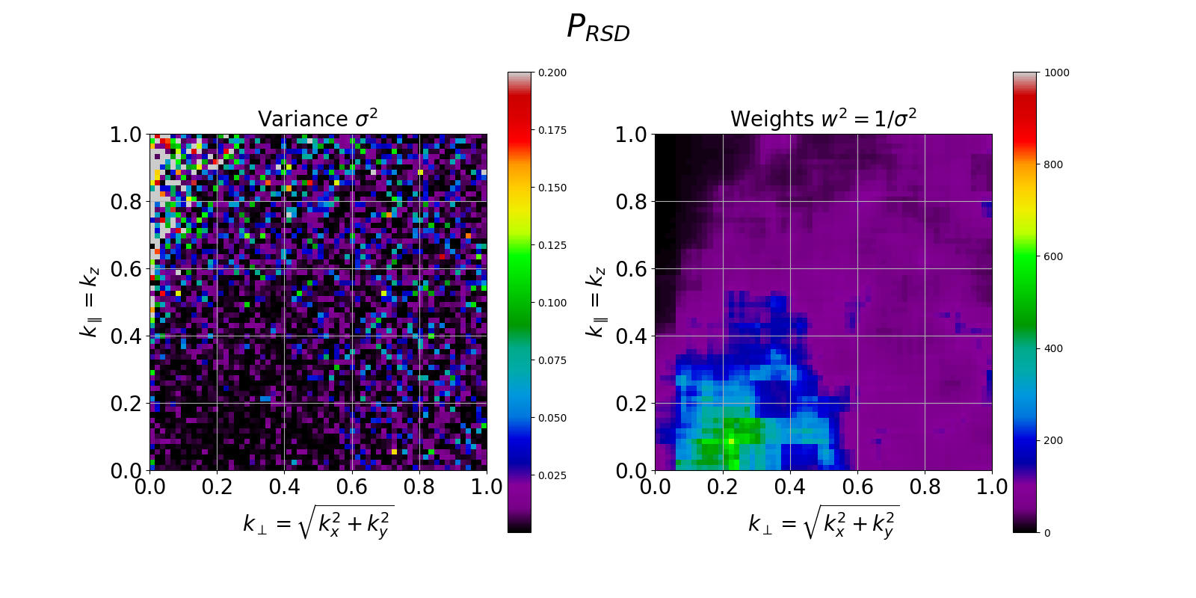
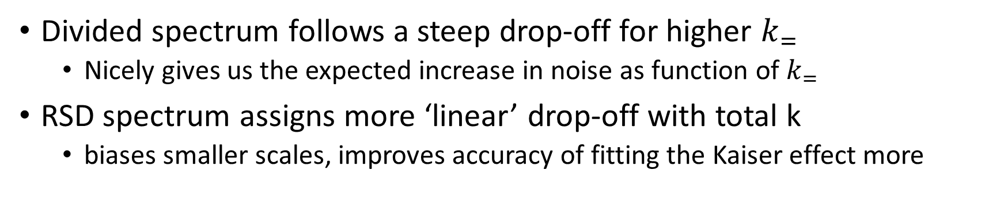
Results/Discussion: Weight
Divided spectrum follows a steep drop-off for higher $k_{=}$
Nicely gives us the expected increase in noise as function of $k_{=}$
RSD spectrum assigns more ‘linear’ drop-off with total k
biases smaller scales, improves accuracy of fitting the Kaiser effect more

Slide 14
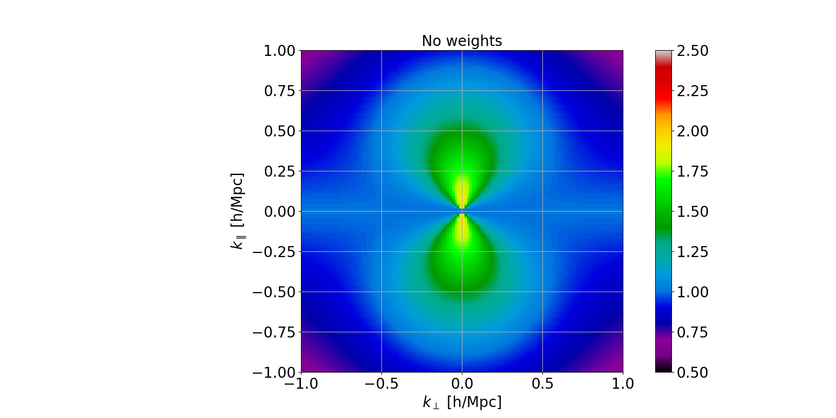
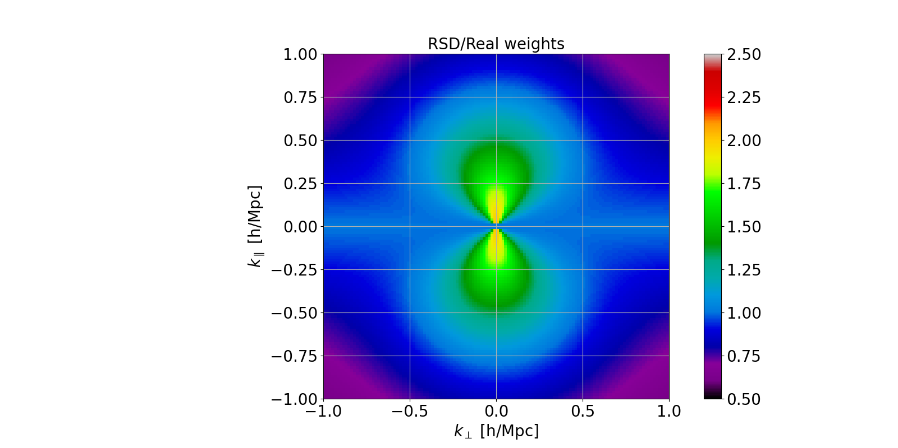
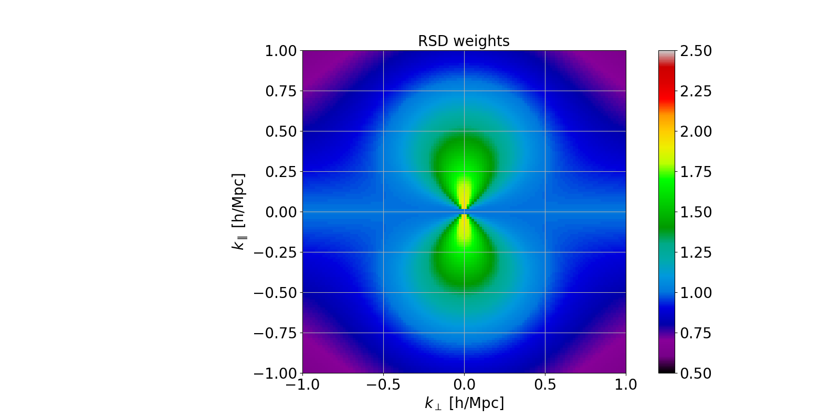
Results/Discussion: Model comparison
Adding weights has a small effect on the model grid

Slide 15
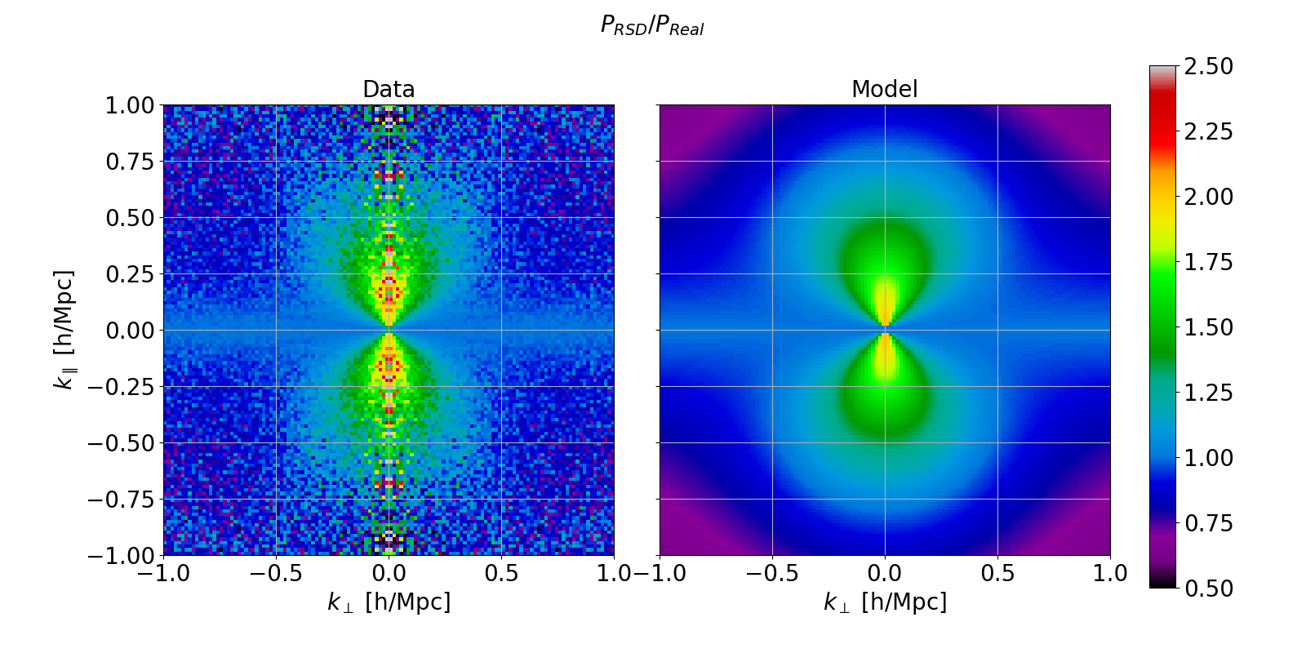
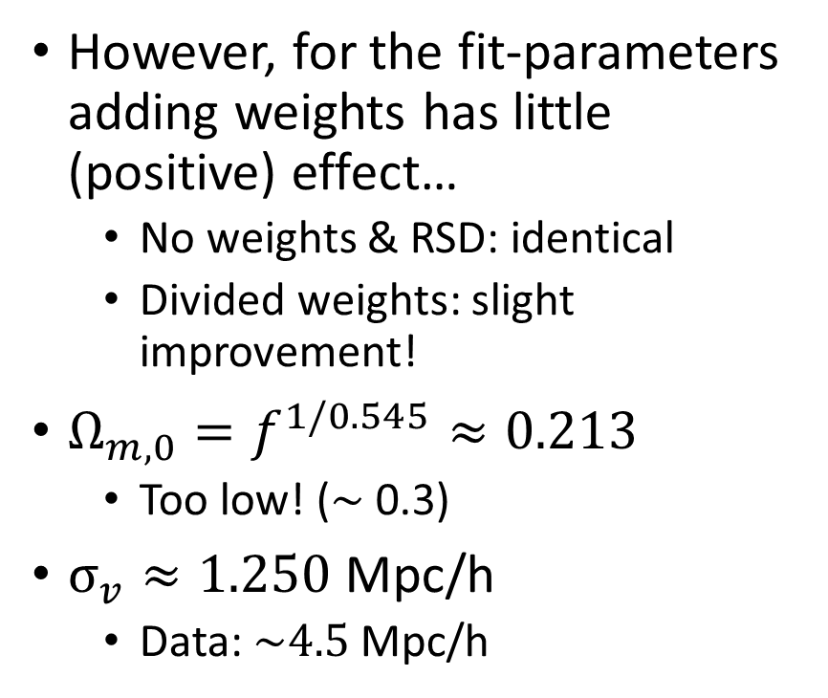
Results/Discussion: Best model of divided grid
However, for the fit-parameters adding weights has little (positive) effect…
No weights & RSD: identical
Divided weights: slight improvement!
$Ω_{m,0}=f^{1/0.545}≈0.213$
Too low! ($\sim$0.3)
$σ_{v}≈1.250$ Mpc/h
Data: $\sim 4.5$ Mpc/h

Slide 16
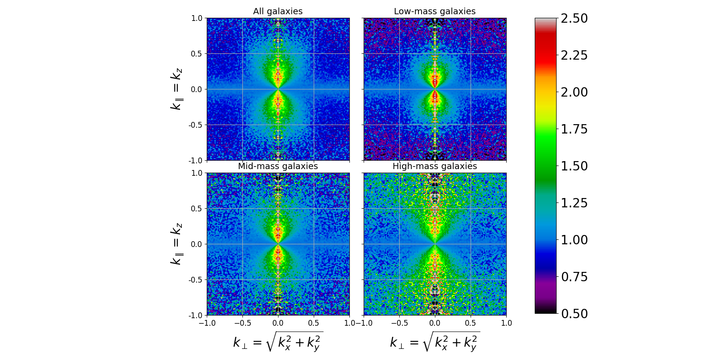

Results/Discussion: Different mass bins
Difference regular and stronger AGN feedback insignificant in terms of RSD
High mass galaxies often near cluster centers and thus have greater random motion, but dispersion decreases!
Various mass bins
Stronger AGN feedback

Slide 17
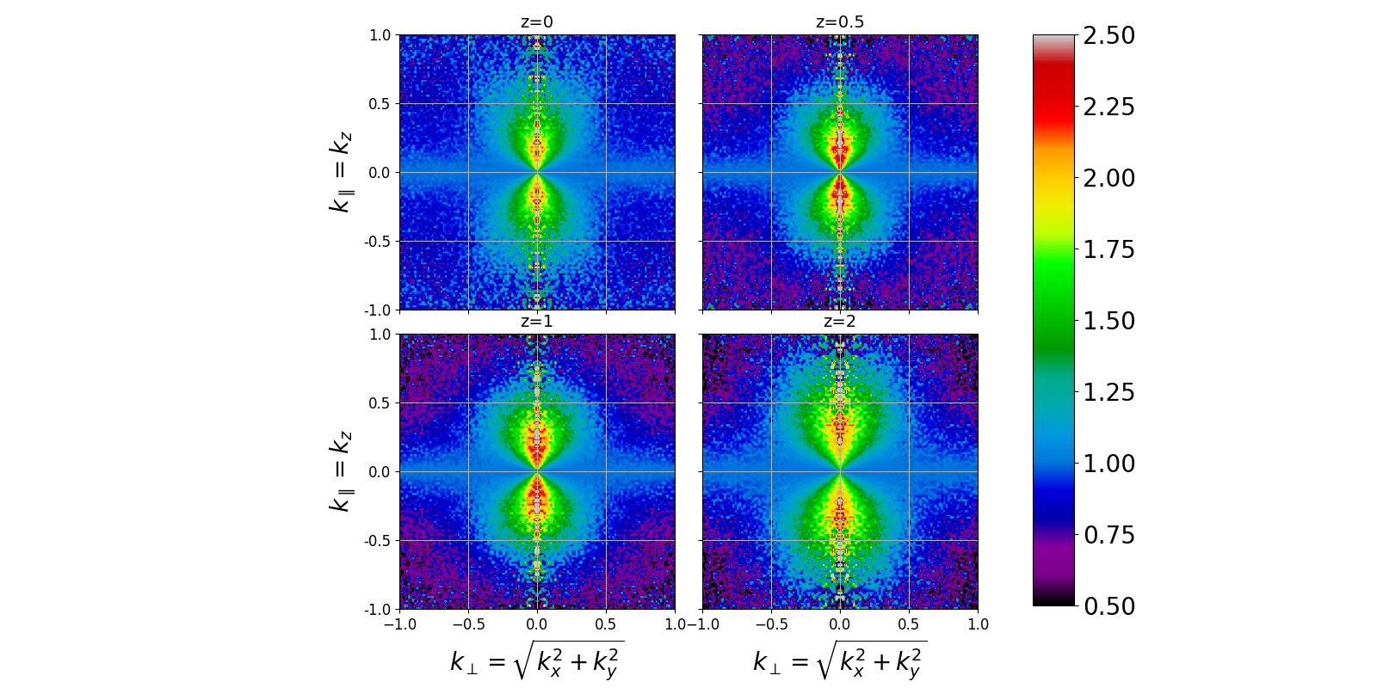
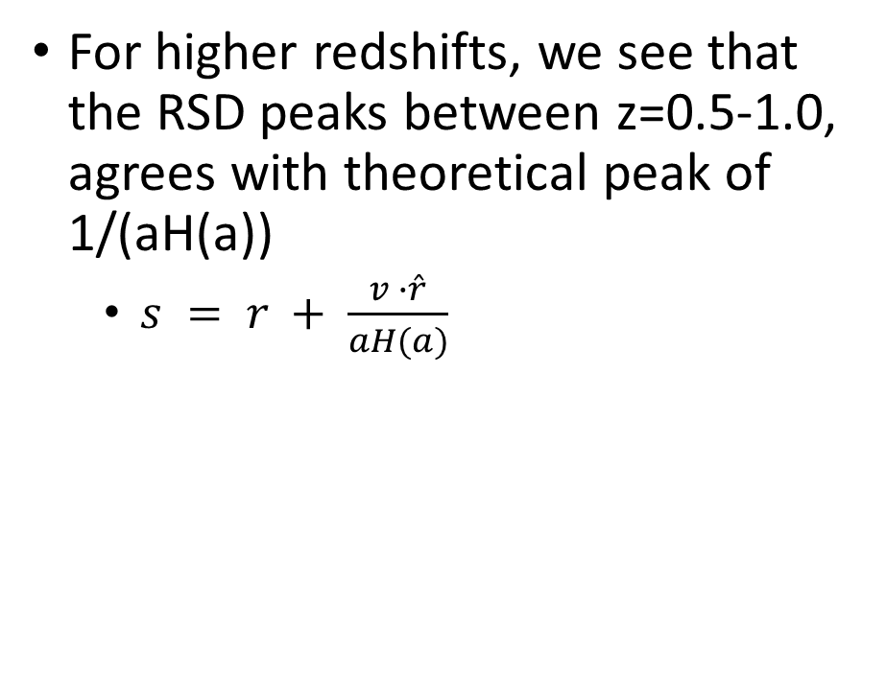
Results/Discussion: Higher redshifts
For higher redshifts, we see that the RSD peaks between z=0.5-1.0, agrees with theoretical peak of 1/(aH(a))
$s = r + \frac{v ∙\hat{r}}{aH(a)}$

Slide 18
Conclusion:
We underestimate the RSD with our model
Likely reason: we do not consider non-linear model terms
Follow-up project to explore these non-linear components would be valuable
There are some positives!
Divided grids follow noise expectations
Creative solution to quantify weights
Pipeline

